Slide 1
Solar Installation Optimization in Colorado
Jaswanth Das Gunturu
Aditya Gidda
Gregory Howard
Bhavya Kavuri
Udaya Mutyala

Slide 2
Contents
Introduction
Information Gathered
Assumptions
Optimization Setup
Results/Test Cases
Conclusions
References

Slide 3

Introduction
Climate change
Solar = effective solution
Costs vary geographically
Efficiency as well
Transmission costs
Solar farms vs residential
Colorado 50% renewable
revisionenergy.com

Slide 4
Information Gathered
Existing solar resources and their installation costs
NREL Open PV Project
Solar Panel Sizing
250 W per 16.5 square feet
Transmission Costs
Expensive per mile ($285,000)
Maintenance Costs
1% per year of development costs
Sun Light Hours
Average in Colorado of usable light (1348 hours)

Slide 5
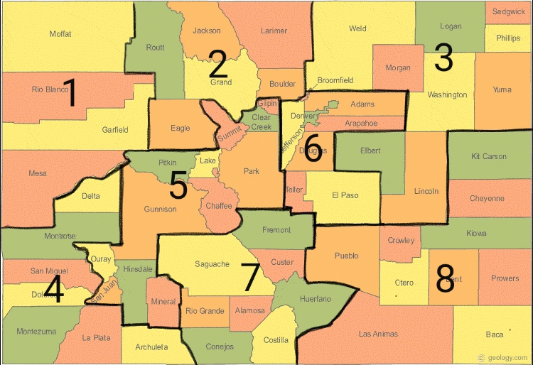
Assumptions
District 6 - Large Population
District 5 - Less Sunlight Due to Mountains
District 7 - Existing Large Solar Developments

Slide 6
Assumptions
Size of solar panel - 250W
Locations of the Solar Farms
Distance from one division to another transmission
1% loss per 100 miles
7% loss for transmission and distribution
Impact of Temperature and weather not taken into consideration
1% development cost per year
Missing values of cost have been imputed by average values of remaining
Land acquisition cost ignored

Slide 7
Optimization Setup
Linear Programming Model in AMPL
Variables
Solar Generation/District
Transmission to Neighboring Districts
Variable Weights
Transmission Losses
Distance and Average
Sunlight Hours per District
Maintenance Costs
Objective Function
Cost of Development and Transmission
Constraints
Energy = Demand for each district
Non negativity for generation and transmissions

Slide 8
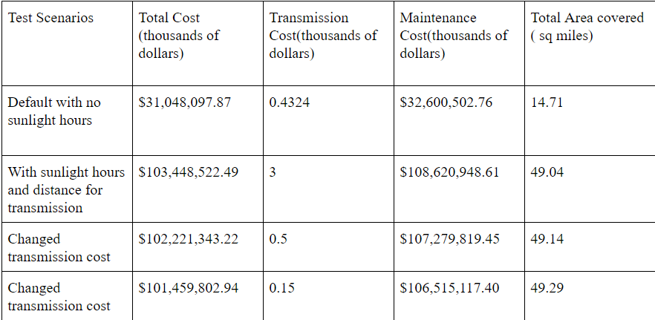
Results/Test Cases

Slide 9
Results/Test Cases
Transmission cost of 2.4 Thousand $/kW upper bound
Electricity generated in all districts
Transmission cost of 0 generates electricity in districts 1, 6 and 8
Transmission losses still affect generation
Approximate cost of transmission of 1.65 Thousand $/kW
Assuming 15 miles required transmission and the average districts’ energy needs
Within range of used values
Notes:
Some of the interesting points in the sensitivity testing of the model
Upper bound where transmission costs are so high that no transmission is picked by the model
Even at zero transmission costs the transmission efficiencies affect the model as losses cause more generation therefore no district ever produces all energy
Approximate cost of transmission fall within range of our tested values meaning that it is important

Slide 10
Conclusions
Complexity increases quickly
Initially considered all counties individually
Model selects either all or nothing
Cost differences between generation and transmission
Model needs built in costs for cheap interconnection
Forces residential development
Costs were inflated
National cost average ($2.8/W) and Colorado cost average ($7/W)
Over two times increase
$103 billion Colorado and $41 billion national
Colorado Needs More Solar
Current 0.3 sq. miles increase to 49 sq. miles (104,185 sq. miles in CO)
Notes:
Complexity - all counties, weather, transmission losses vary by area as well
All or Nothing - When differences in generation costs are reached by transmission costs then districts generate all their own
Currently a district could produce no energy even though costs of residential development can be very low in some situations
Costs were over two times higher than expected given national average
I

Slide 11
References
https://news.energysage.com/250-watt-solar-panels-are-they-right-for-you/
https://openpv.nrel.gov/
https://en.wikipedia.org/wiki/Electric_power_transmission
https://www.elp.com/articles/powergrid_international/print/volume-18/issue-2/features/underground-vs-overhead-power-line-installation-cost-comparison-.html
http://insideenergy.org/2015/11/06/lost-in-transmission-how-much-electricity-disappears-between-a-power-plant-and-your-plug/
http://www.longtermsolar.com/solar-sunlight-hours-in-colorado/
https://www.nrel.gov/docs/fy17osti/68281.pdf

Slide 12
THANK YOU

